Slide 1
Principles of Enzyme Catalysis

Slide 2
Thermodynamics is concerned with only the initial and final states of a process, being independent of the path(s) between the two states.
Kinetics is concerned with the rate at which the process occurs and thus is concerned with the path(s) between the two states.
The parable of the sugar packet

Slide 3
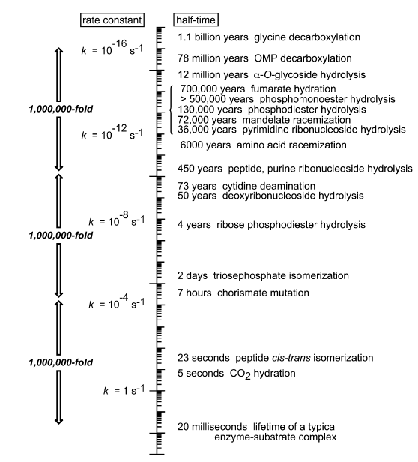
Time Scale for Selected Biochemically Important Reactions
Carbonic anhydrase
k_{cat} = 20 x 10⁶ s⁻¹
Wolfenden, R. (2003) Thermodynamic and extrathermodynamic requirements of enzyme catalysis. Biophys. Chem. 105, 559-572.

Slide 4
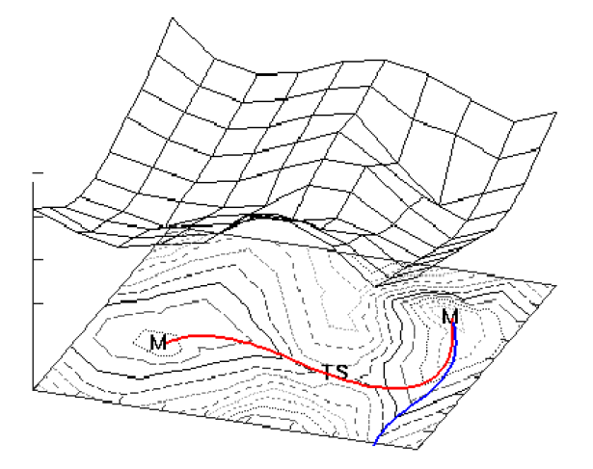

Slide 5
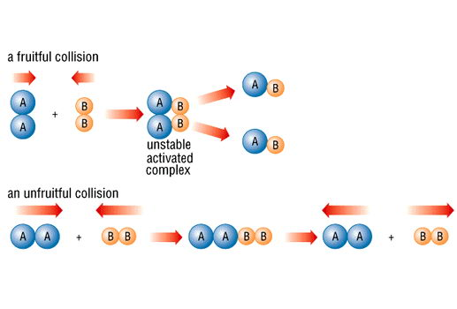
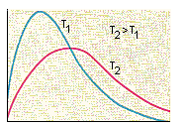
Collision Theory
Boltzmann distribution
ΔG‡
Number of molecules
Kinetic energy
k = (γk_{B}T/h) C^{1-n} e^{-ΔG‡/RT}
is inversely proportional to the height of the barrier (ΔG‡) but proportional to temperature
is proportional to the concentration of reactants
is proportional to the probability of a productive collision
The rate constant for the reaction

Slide 6
Encounter Complex
In this encounter complex there is a greater probability that the reactants will collide rather than diffuse apart.
As two reactants diffuse together they become caged by the surrounding water molecules.

Slide 7
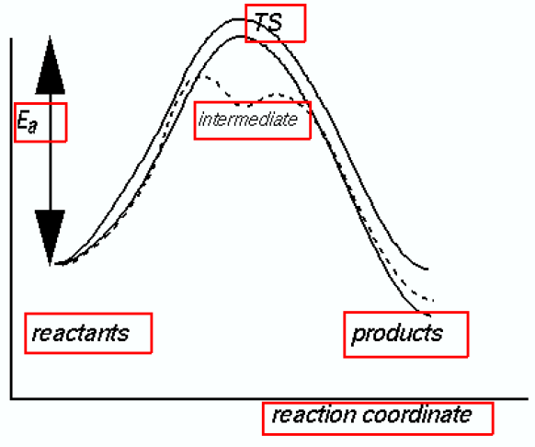
ΔG‡ = ΔH‡ -TΔS‡
ΔG = ΔH -TΔS

Slide 8
Potential Mechanisms for Enzyme Catalytic Efficiency
By binding substrates in the active site, enzymes can increase the effective local concentrations of reactants (Proximity effects)
Substrate binding can correctly orient reacting groups in the active site (Orbital steering)
Enzymes can promote desolvation upon substrate binding
Enzymes can enhance the inherent reactivity of functional groups by altering the microenvironment within the active site

Slide 9
Entropy-Enthalpy Compensation
The unfavorable entropy of activation (ΔS‡) of bringing the reactants together into the encounter complex is compensated by the favorable enthalpy of binding (ΔH) of the reactants in the active site.
By binding substrates in the active site, enzymes can produce effective concentrations orders of magnitude greater than can be achieved in the absence of the catalyst.

Slide 10
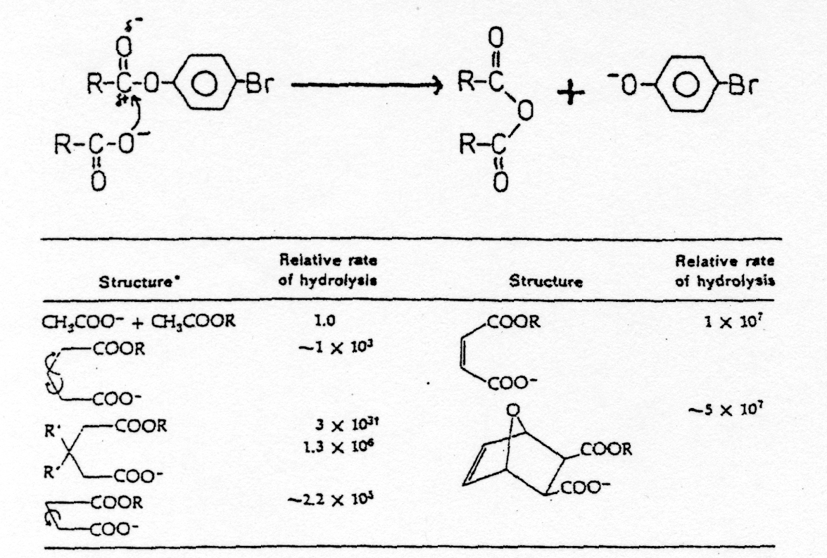
Proximity Effects

Slide 11
Induced Fit (Transition State Binding)
Wolfenden, R. (2003) Biophys. Chem. 105, 559-572

Slide 12
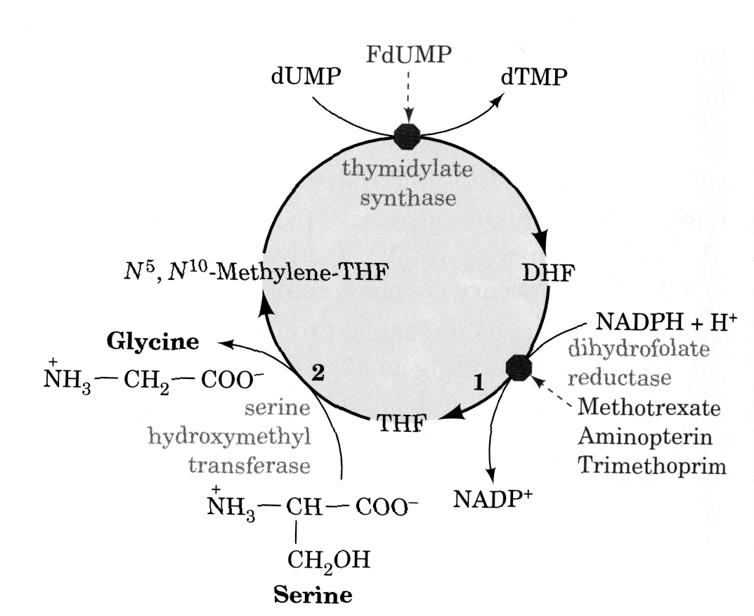
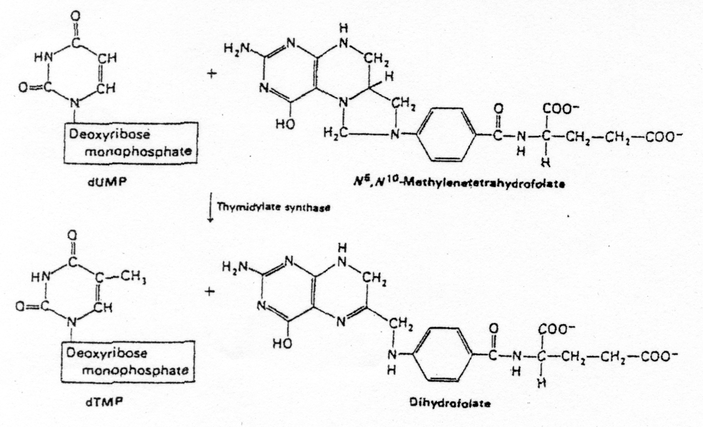
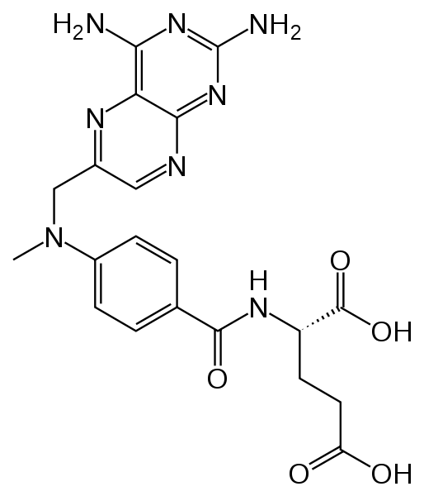
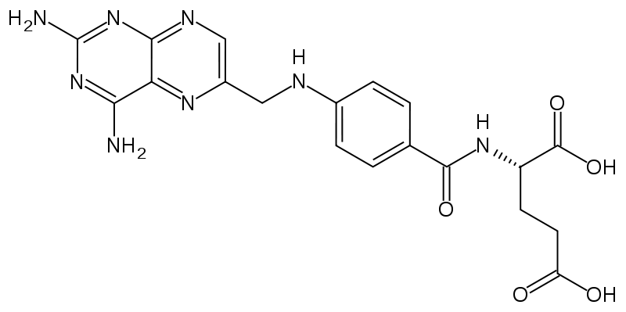
Induced Fit (Transition State Binding)
Methotrexate
Aminopterin

Slide 13
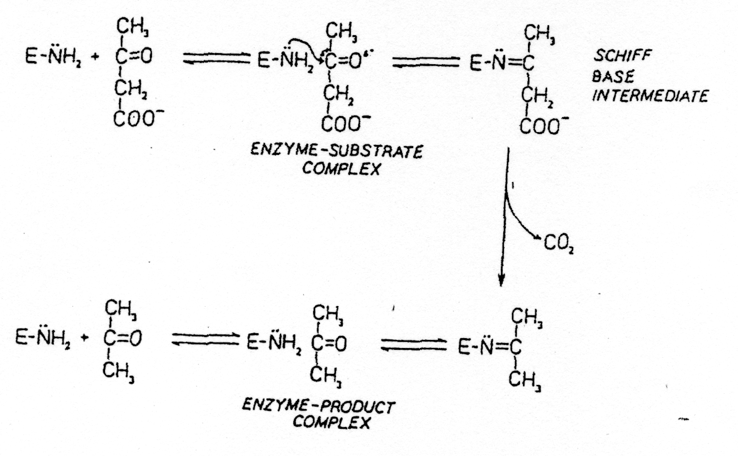
Microenvironment Effects
Mechanism of Acetoacetate Decarboxylase

Slide 14
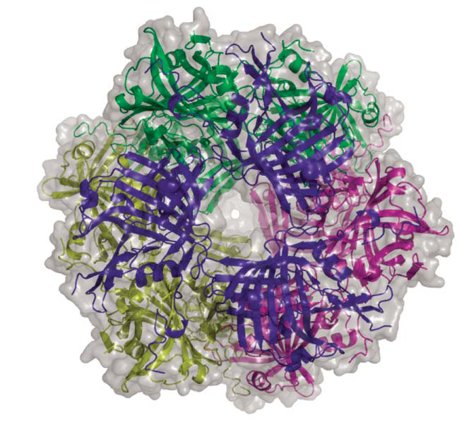
Ho et al. (2009) Nature 459, 393-397

Slide 15
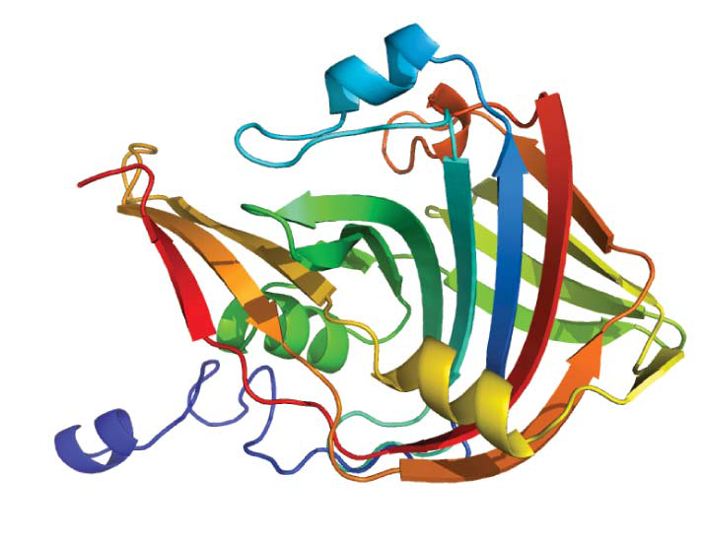
Ramped N-terminus to C-terminus
Lys¹¹⁵
Substrate Schiff base
Arg²⁹
Ho et al. (2009) Nature 459, 393-397

Slide 16
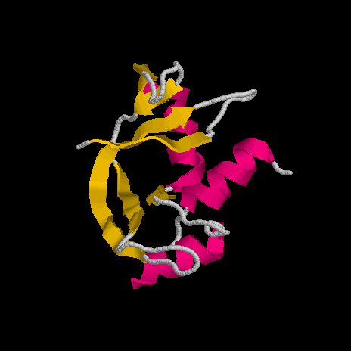
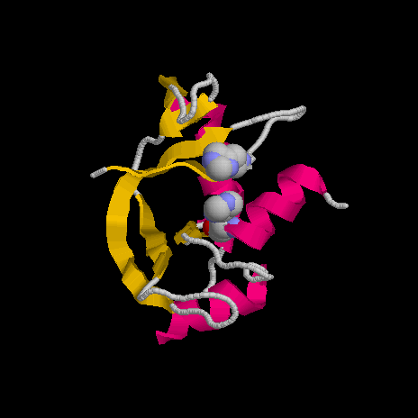
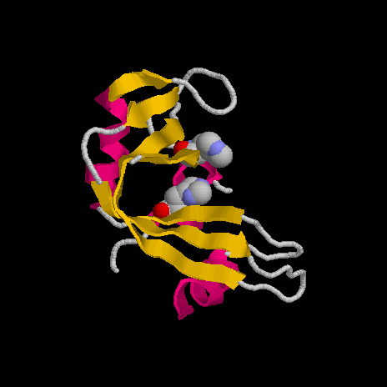
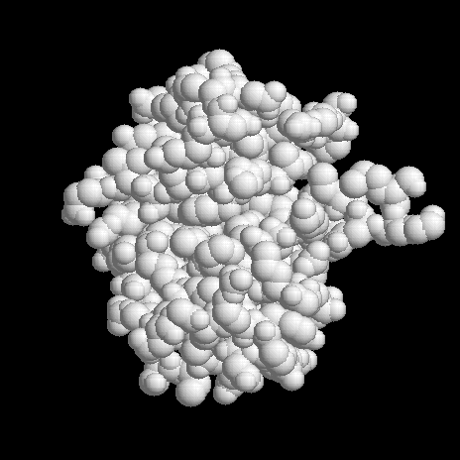
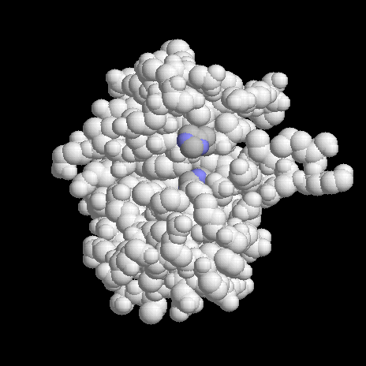
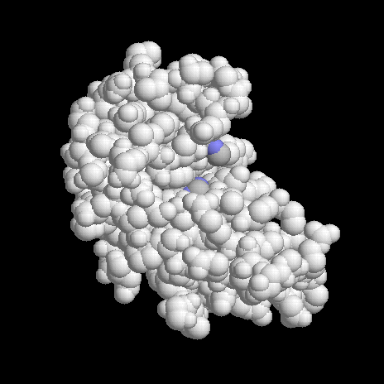
General Acid-Base Catalysis
Human Pancreatic Ribonuclease
His²¹⁹
C
N
His¹¹²

Slide 17
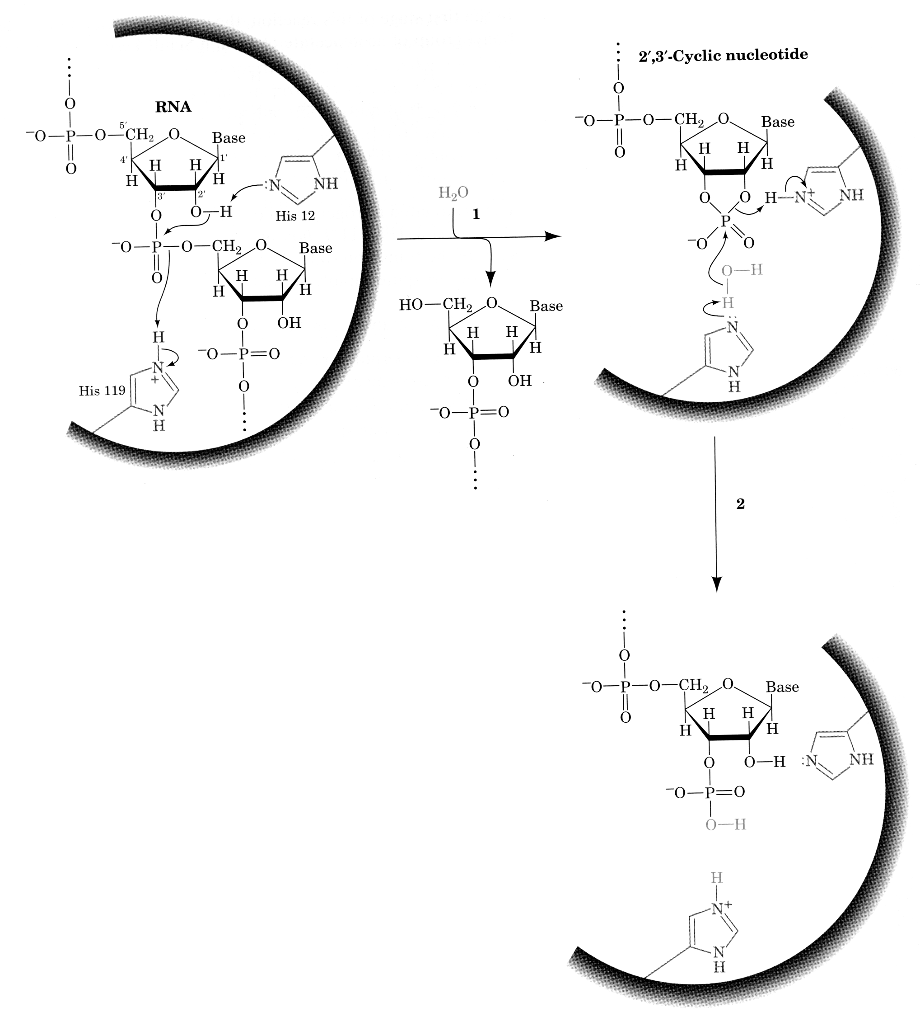
General Acid-Base Catalysis
Mechanism of Ribonuclease

Slide 18
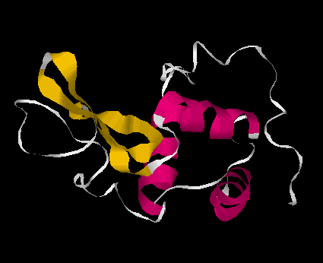

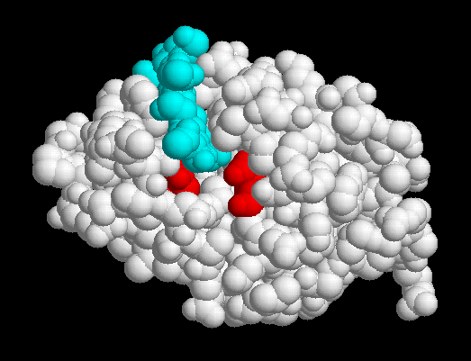
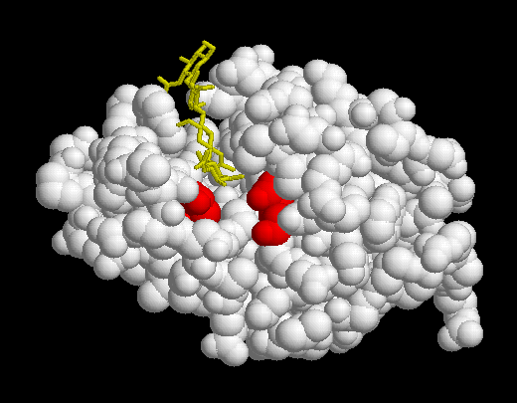
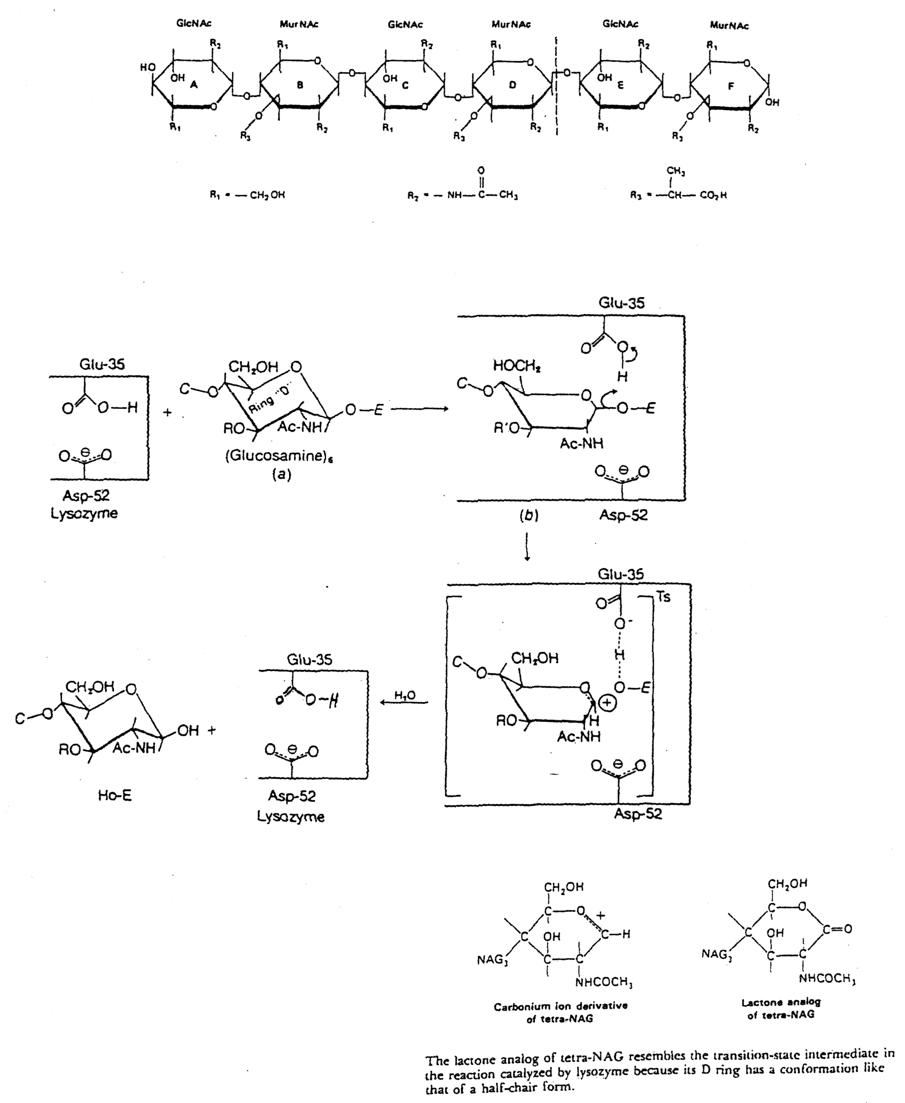
Induced Fit in the Mechanism of Lysozyme
E35
D52
C
C
Rings A-D
Rings A-D

Slide 19
Vocadlo et al. (2001) Nature 412, 835-838

Slide 20
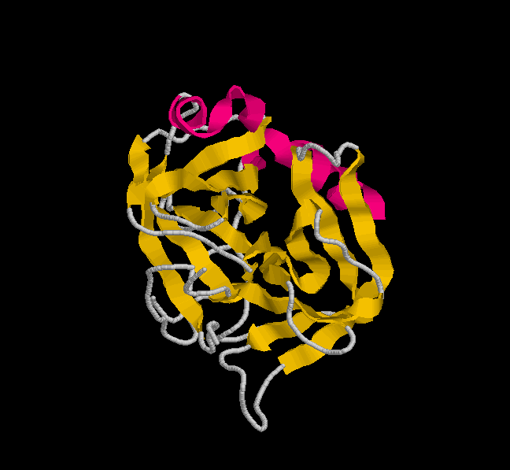
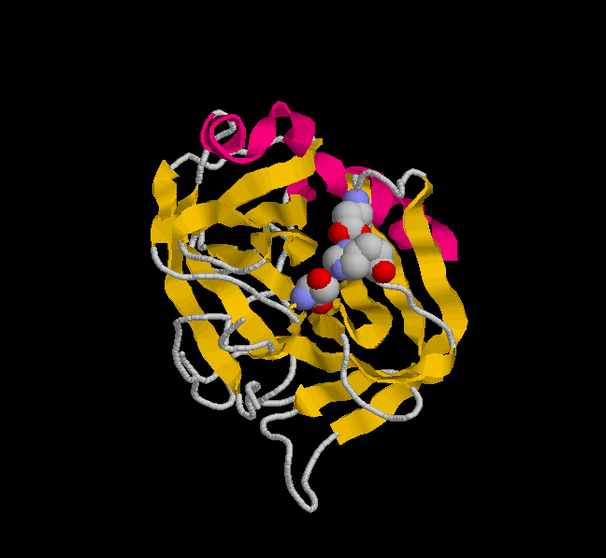
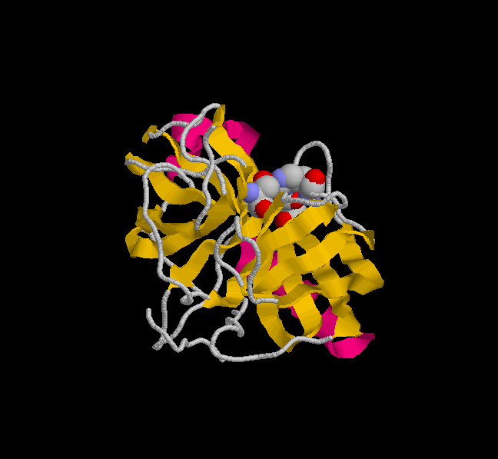
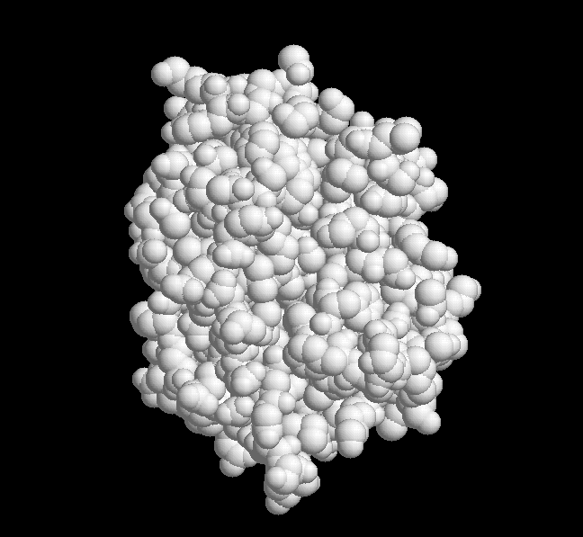
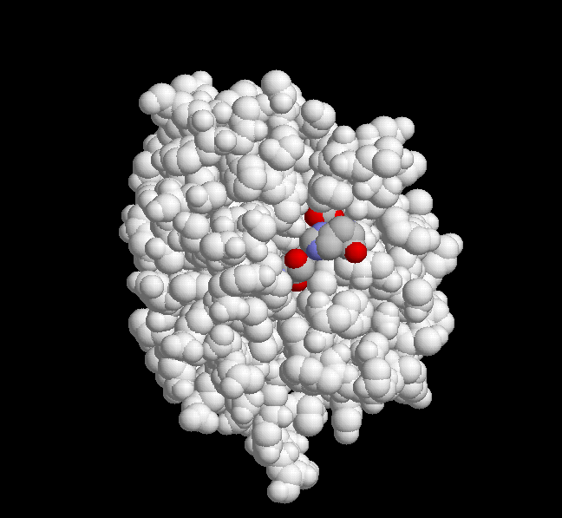
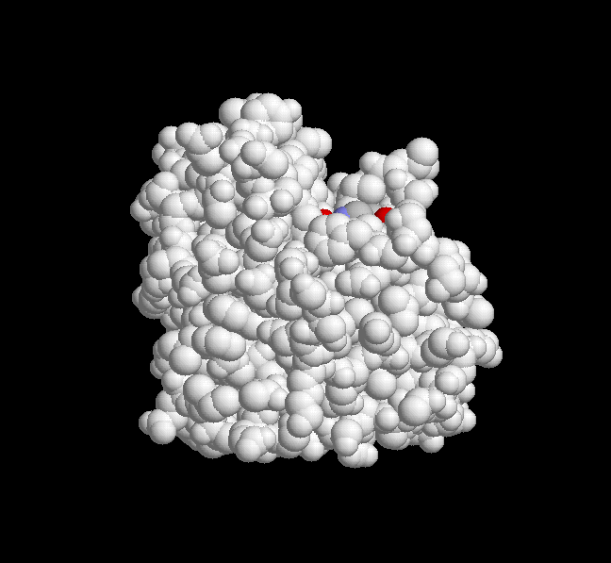
Covalent Catalysis in the Serine Proteases
Asp¹⁰²
His⁵⁷
Ser¹⁹⁵

Slide 21
